Slide 1
Constructors that takes parameters
It is possible to pass arguments to a constructor function.
To allow this, simply add the appropriate parameters to the constructor function’s declaration and definition.
Then, when you declare an object, specify the arguments.

Slide 2
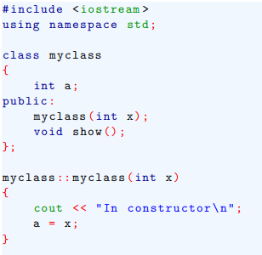
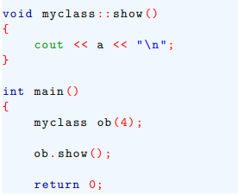
Constructors that takes parameters
Example-

Slide 3
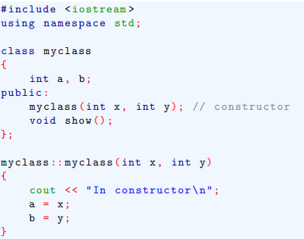
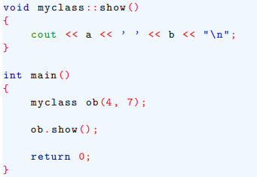
Constructors that takes parameters
Example- a constructor more than one argument

Slide 4
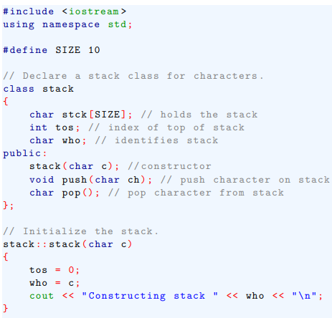
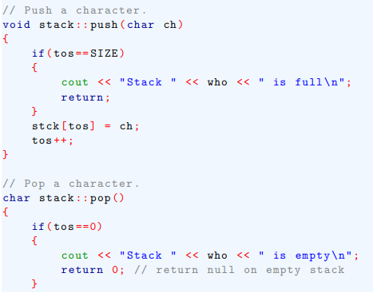

Constructors that takes parameters
Another version of stack class that uses parameterized constructor.

Slide 5
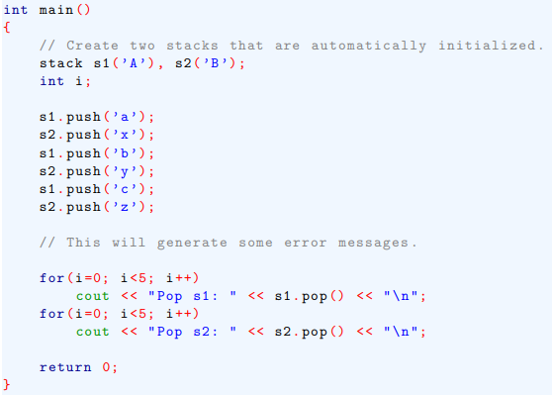
Constructors that takes parameters
Another version of stack class that uses parameterized constructor.

Slide 6
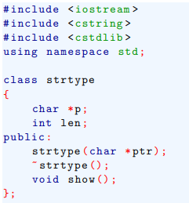

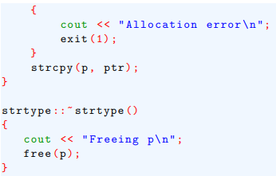
Constructors that takes parameters
Here is different way to implement the strtype class (developed earlier) that uses a parameterized constructor function.

Slide 7
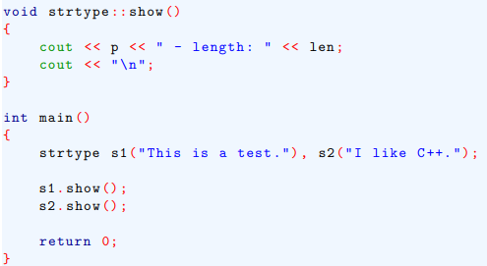
Constructors that takes parameters

Slide 8
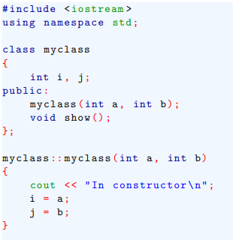
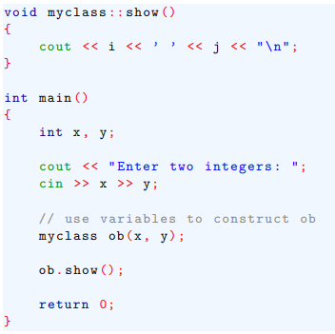
Constructors that takes parameters
We can pass an object’s constructor any valid expression, including variables.

Slide 9


Constructors that takes parameters
Lab works –

